Slide 1
Stress

Slide 2
Pressure turns into stress when you feel unable to cope. People have different ways of reacting to stress, so a situation that feels stressful to one person may in fact be motivating to another.
Stress can affect how you feel, how you think, how you behave and how your body works

Slide 3
Signs of Stress
Changes in mood
Clammy or sweaty palms
Diarrhea
Difficulty sleeping
Digestive problems
Dizziness
Feeling anxious
Grinding teeth
Headaches
Low energy
Muscle tension, especially in the neck and shoulders
Physical aches and pains
Racing heartbeat
Trembling

Slide 4
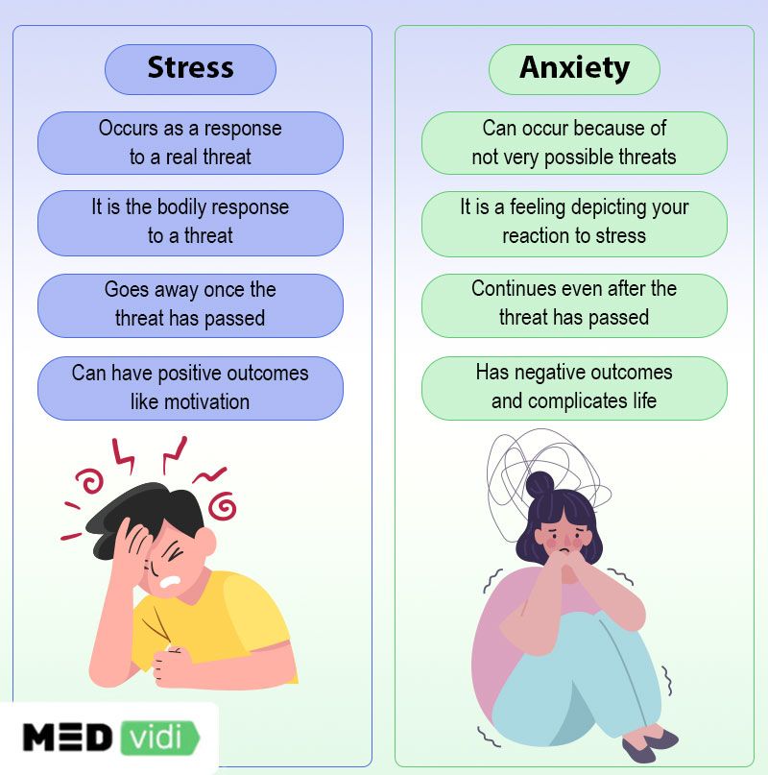

Slide 5
Identifying Stress
It often contributes to irritability, fear, overwork, and frustration. You may feel physically exhausted, worn out/tired, and unable to cope.
Stress is not always easy to recognize, but there are some ways to identify some signs that you might be experiencing too much pressure. Sometimes stress can come from an obvious source, but sometimes even small daily stresses from work, school, family, and friends can take a toll on your mind and body.

Slide 6
Psychological signs such as difficulty concentrating, worrying, anxiety, and trouble remembering.
Emotional signs such as being angry, irritated, moody, or frustrated.
Physical signs such as high blood pressure, changes in weight, frequent colds or infections.
Behavioral signs such as poor self-care, not having time for the things you enjoy, or relying on drugs to cope.

Slide 7
Causes of Stress
There are many different things in life that can cause stress. Some of the main sources of stress include
Work,
Finances,
Relationships difficulties
Parenting, and day-to-day inconveniences.

Slide 8
Internal Causes
Chronic worry
Negative self-talk
Unrealistic expectations
All or nothing attitude

Slide 9
Types of Stress
Acute stress: Acute stress is a very short-term type of stress that can either be positive or more distressing; this is the type of stress we most often encounter in day-to-day life.
For example, if you have recently been involved in an argument, you may have acute stress related to negative thoughts that are repetitive about the argument.

Slide 10
Episodic acute stress
When acute stress happens frequently, it’s called Episodic acute stress.

Slide 11
Chronic stress
Chronic stress is stress that seems never-ending, like the stress of a bad marriage or an extremely challenging job; chronic stress can also stem from traumatic experiences and childhood trauma.

Slide 12
Coping With Stress
Learn to recognize the signs of burnout. High levels of stress may place you at a high risk of burnout. Burnout can leave you feeling exhausted and apathetic about your job. When you start to feel symptoms of emotional exhaustion, it's a sign that you need to find a way to get a handle on your stress.

Slide 13
Try to get regular exercise.
Take care of yourself. Incorporating regular self-care activities into your daily life is essential to stress management. Learn how to take care of your mind, body, and spirit and discover how to equip yourself to live your best life.
Practice mindfulness in your life. Mindfulness isn't just something you practice for 10 minutes each day. It can also be a way of life. Discover how to live more mindfully throughout your day so you can become more awake and conscious throughout your life.

